Slide 1
Chapter 12

Slide 2
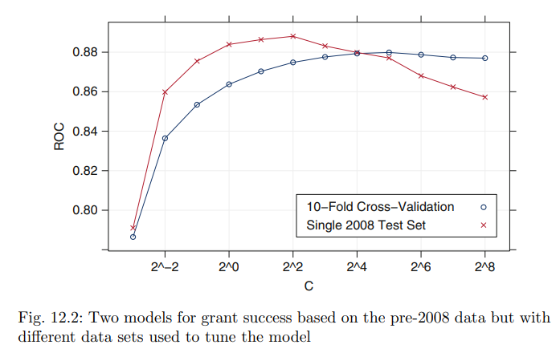
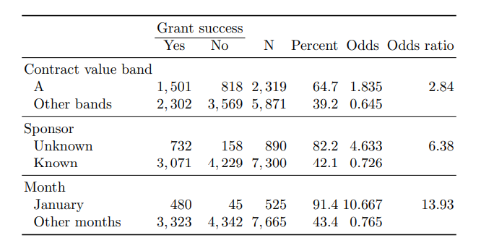
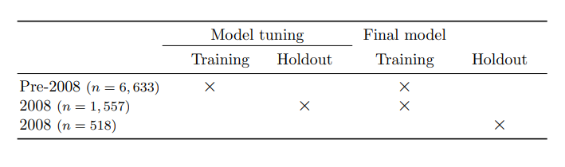
Case study
Full set / reduced set
Reduced set was developed for models that are sensitive
Univariate review
Train / test data split
A: Take all available from 2005 ~ 2008
B: train on pre-2008, tune on 2008

Slide 3
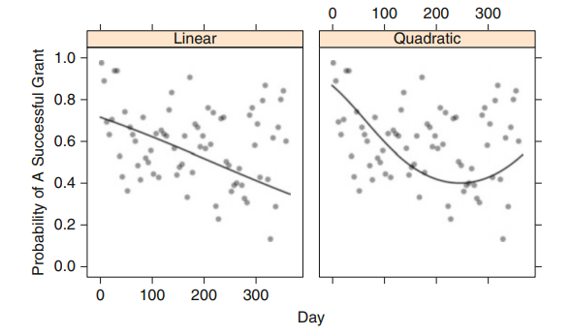



Logistic regression
Full set / reduced set
Full set
ROC 0.78, sensitivity 77%, specificity 76.1%
Reduced set
ROC 0.87, sensitivity 80.4%, specificity 82.2%

Slide 4

Linear Discriminant Analysis
Welch & Fisher
Welch
Minimize the total probability of misclassification
Fisher
Maximize the between-group variance relative to the within-group variance
ROC 0.89, sensitivity 80.4%, specificity 82.3%

Slide 5
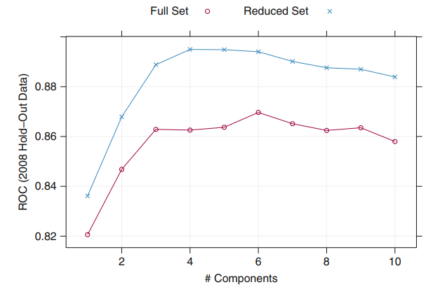
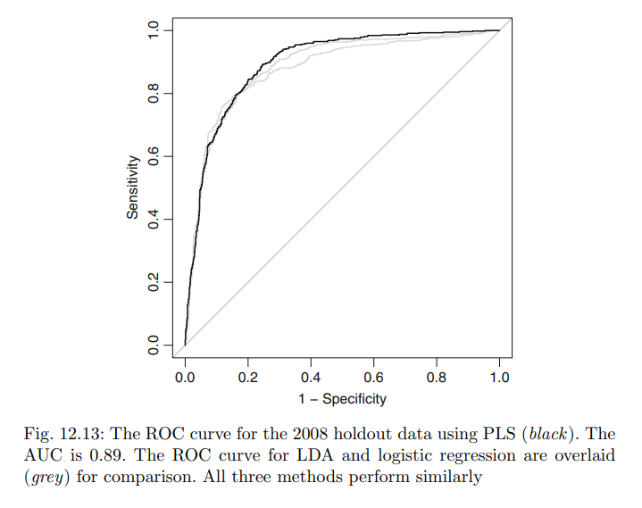
Partial least squares discriminant analysis
PLS + LDA
Benefit
Tuning parameter
Number of latent variables

Slide 6
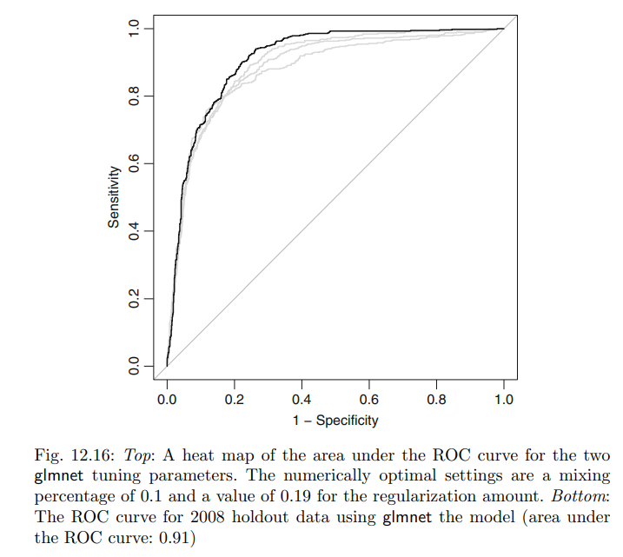
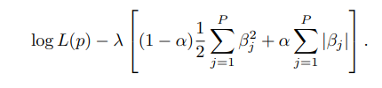
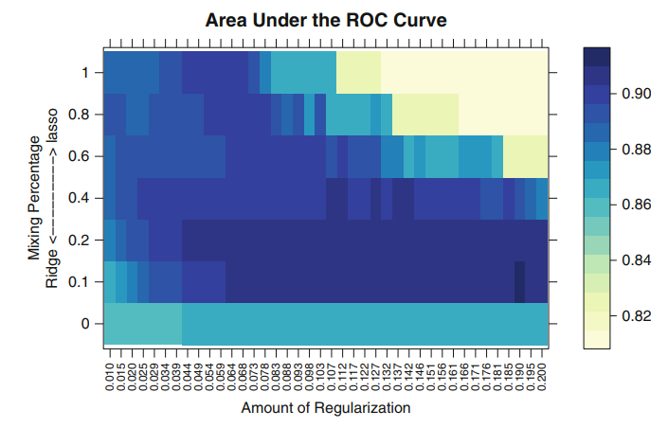
Penalized Models
Add regulation part

Slide 7
Nearest shrunken Centroids
Class Centroid:
Taking the avg value of each predictor in the training set
Overall centroid:
Using data from all of the classes
Classify unknown sample
Find the closest class centroid in the full dimensional space
Choose that class for prediction
ROC 0.87 sensitivity 83.7%, specificity 77%

